Slide 1
Data Analysis on Stack Overflow Data
Project Proposal
By Sharadha S (Shar)

Slide 2
Outline
The Situation
Research Questions
The Data
Methodology
Results
Conclusion

Slide 3
The Situation

Slide 4
Scenario
Data Science is a fast evolving field, and it can get difficult to keep track of all the new technologies and tools being used.
Data Science is also a wide topic ranging from data engineering to data analysis.
With the field being more and more in demand, it is important for data scientists to know the trends in data science and how it’s changing.

Slide 5
Problem statement
How to keep track of all the latest trends in data science?
As a data scientist, it is important for all of us to keep ourselves updated with all the new technologies, challenges and changes happening in the data science world.
What tools are all the data scientists using today?
Are these softwares/libraries fully developed? Do they have a lot of bugs to be fixed?
Is there a strong interactive community to help with these tools?

Slide 6
The Solution
The largest online community of developers - Stack Overflow
What better way to keep track of the trends in data science than to analyze data from the largest community for developers?
Analyzing posts and interactions on Stack Overflow over a year would give us a clear idea of what is going on in the world of data science.

Slide 7
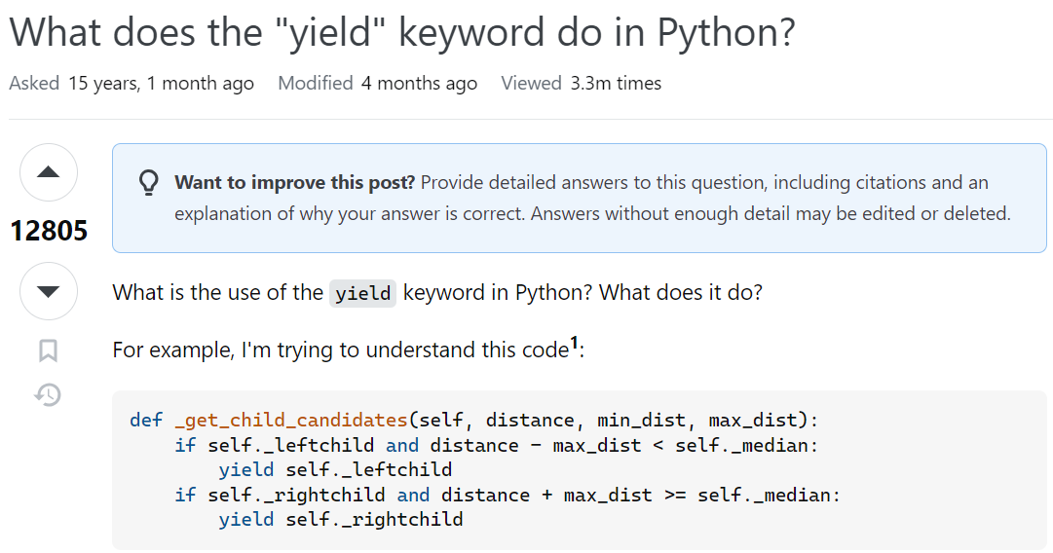
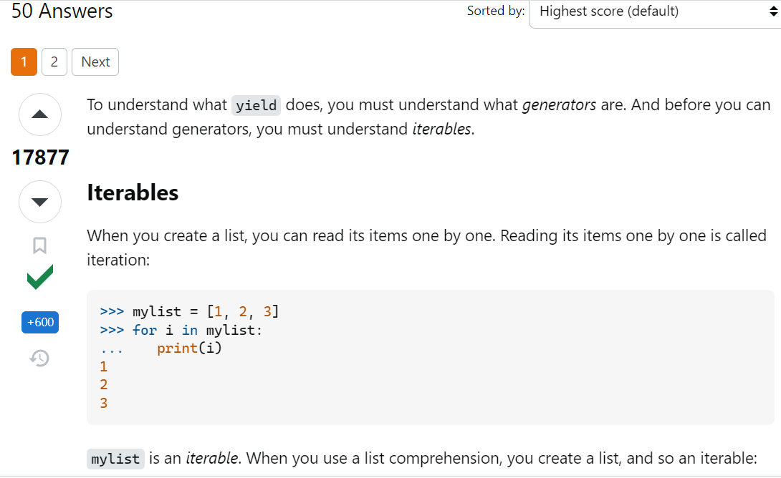
What is StackOverflow?
Ask a question
Get answers!

Slide 8
Research Questions

Slide 9
The main focus of this project, like we said, is to discover trends in data science online.
Here are a few of the questions we will be asking our dataset:
What were the most talked about topics in Data Science?
How did the trends in topics change through the months?
What topics did data scientists face the most problems in?
What tags attracted the most viewers?
What are the scores of these tags?

Slide 10
The Data

Slide 11
SOME POST ATTRIBUTES
We will be extracting stack overflow data from data.stackexchange.com.
The data will encompass all posts of the year 2022 which have the tag “data science” in them.
The “Posts” table has 23 attributes, some of which are PostID, Body, Tags, Score, AnswerCount, etc.
1
PostID
Score
View Count
Body
Creation Date
Title
Tags
Answer Count
Comment Count
Last Activity Date

Slide 12
Methodology

Slide 13
Data extraction - Extracting year 2022 data from data.stackexchange.com in csv format.
Data Wrangling- Dealing with null values, removing unwanted columns and putting the data in the right format.
Inverted Index - Inverted indexing method with MapReduce to make analysing based on tags easier.
EDA - perform basic Data Analysis in Python using simple charts
Text Analytics of posts to get important words, emotions, etc. This includes: Topic Analysis, Sentiment Analysis and Text Vectorization.
Data visualization - Creating an interactive dashboard with PowerBI that answers more research questions.

Slide 14
The Results

Slide 15
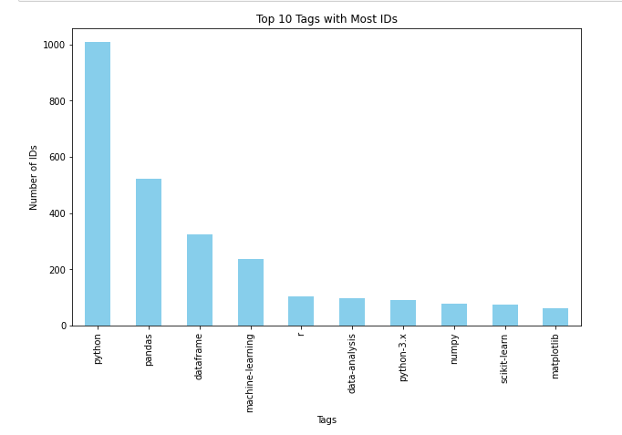
The most talked about Topics
Method 1:
What tags were people using the most?

Slide 16
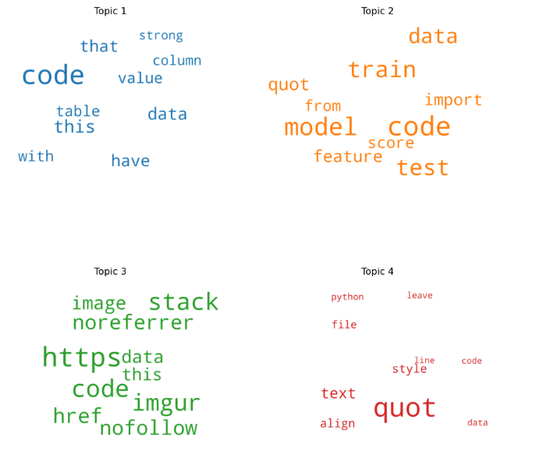
The most talked about Topics
Method 2:
Topic Modelling - top 4 topics of 2022:
Tabular Data
Machine Learning Models
IMGUR and HTTP Requests
Text data and styling

Slide 17
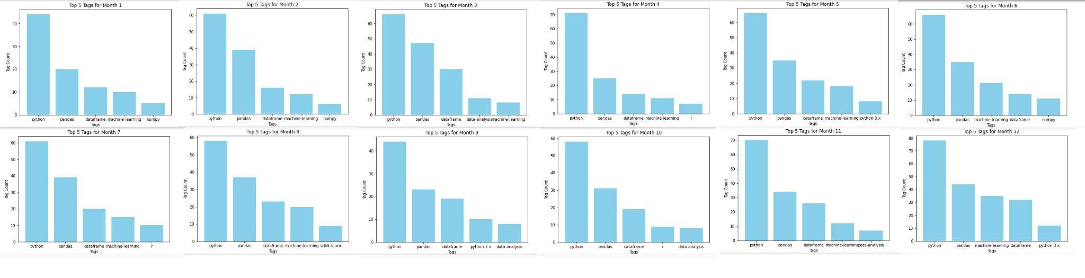
Trends in topics through the months

Slide 18
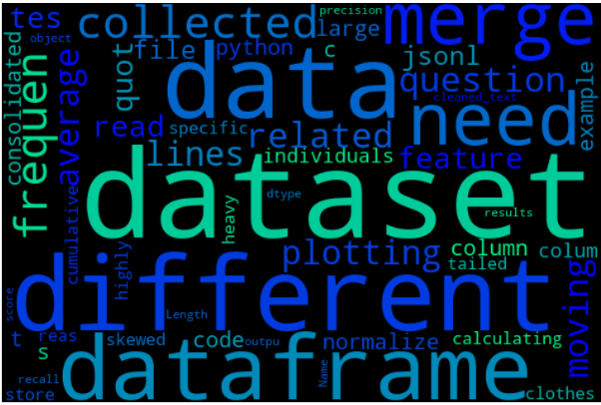
Topics with most problems faced
Method 1:
WordCloud of negative sentiments
A lot are common words in data science - data, dataset, dataframe
Topics that made this cut:
jsonl (JSON Lines files)
Merging
Skewed data

Slide 19
Topics with most problems faced
Method 2:
Word vectorization to get a vector space, and find words most similar to a specific word.
Findings:
Words closest to “error” are ‘model’ , ‘train’ , ‘import’, ‘test’ and ‘file’
This means most problems were encountered with training and testing ML models, and importing files.

Slide 20
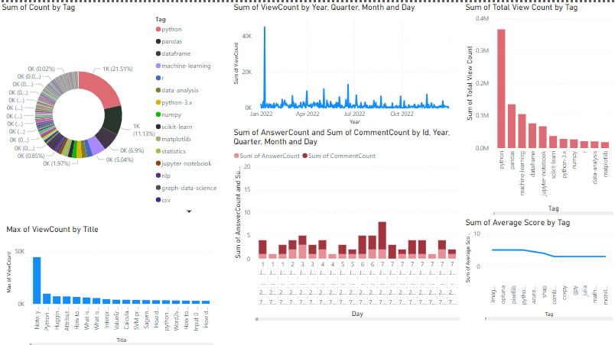

Slide 21
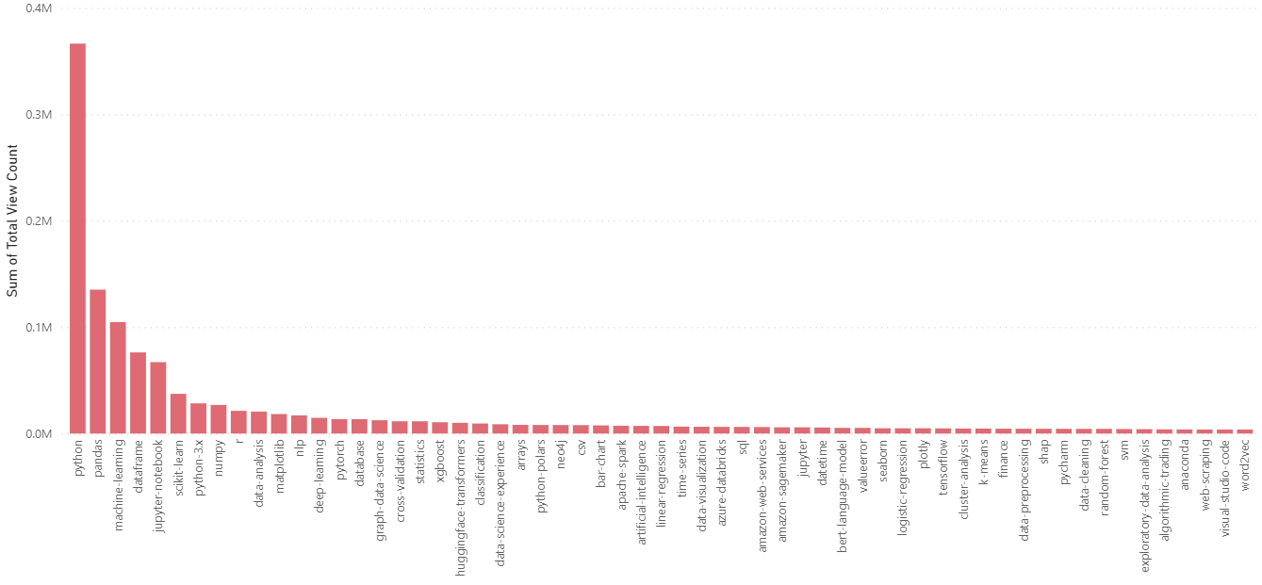
Most Viewed Topics
Python, pandas, machine learning, dataframe and jupyter notebook dominated views
Other top contesters:
Nlp, deep learning, neo4j, artificial intelligence

Slide 22
Highest and lowest Scores
Context: Score = Upvotes - Downvotes
Why does it matter?
Tags with lower average scores were more disputed and unsolvable.
Tags with high average score have more solvable issues and active helpful community.

Slide 23
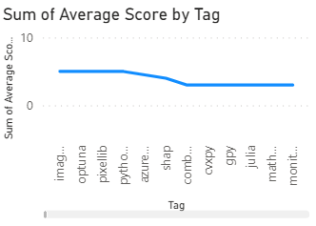
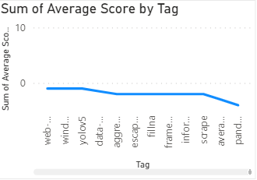
Highest and lowest Scores
TOP SCORES
Image segmentation, optuna, pixellib, azure-databricks
LOWEST SCORES
Pandas-loc , scrape, data-mining, yolov5, web-crawler

Slide 24
Conclusion
There was a lot happening in data-science in 2022.
Highlights:
Data scientists still love using python and jupyter notebook.
Libraries - pandas, numpy, scikit-learn and matplotlib
Hot topics - Machine Learning, AI, data-analysis
Most errors/ issues - ML train & test, JSON files, data mining
Best community - image segmentation, Optuna and azure-databricks

